Slide 1
From On-Premise to Cloud:
Lessons Learned from an Enterprise AWS Migration at Fannie Mae
Wujian Xue
Oct 2026
Cincinnati, OH

Slide 2
Agenda
Background

Slide 3



Background
7 Rs in AWS Cloud Migration
What is the problem and why

Slide 4
What has been done about it?

Slide 5
Steps for refactoring
Data
model
output
Data Prep
Variables: filter data,
merge tables
  Concatenate
  match merging (with n= dataset option)
date/month/time,
missing values,
N/A

Slide 6
Steps for refactoring
data
model
output

Slide 7



Major SAS Steps/Proc vs R package/functions
Enterprise Modeling and Analytics – the Cash Flow model
Data: date/month/time, missing values, N/A
Variables: filter data,
merge tables
  Concatenate
  match merging (with n= dataset option)
Models: logistic regression with splines
  Choose number and location of the knots.
Macro functions
Output

Slide 8
Steps for refactoring
What have I done about it?
Enterprise Modeling and Analytics – the Cash Flow model
SAS: PROC compare
R: compared
How to make a tolerance level?
Enterprise Modeling and Analytics – the Cash Flow model
Data: date/month/time, missing values, N/A
Variables: filter data,
merge tables
  Concatenate
  match merging (with n= dataset option)
Models: logistic regression with splines
  Choose number and location of the knots.
Macro functions
Output

Slide 9
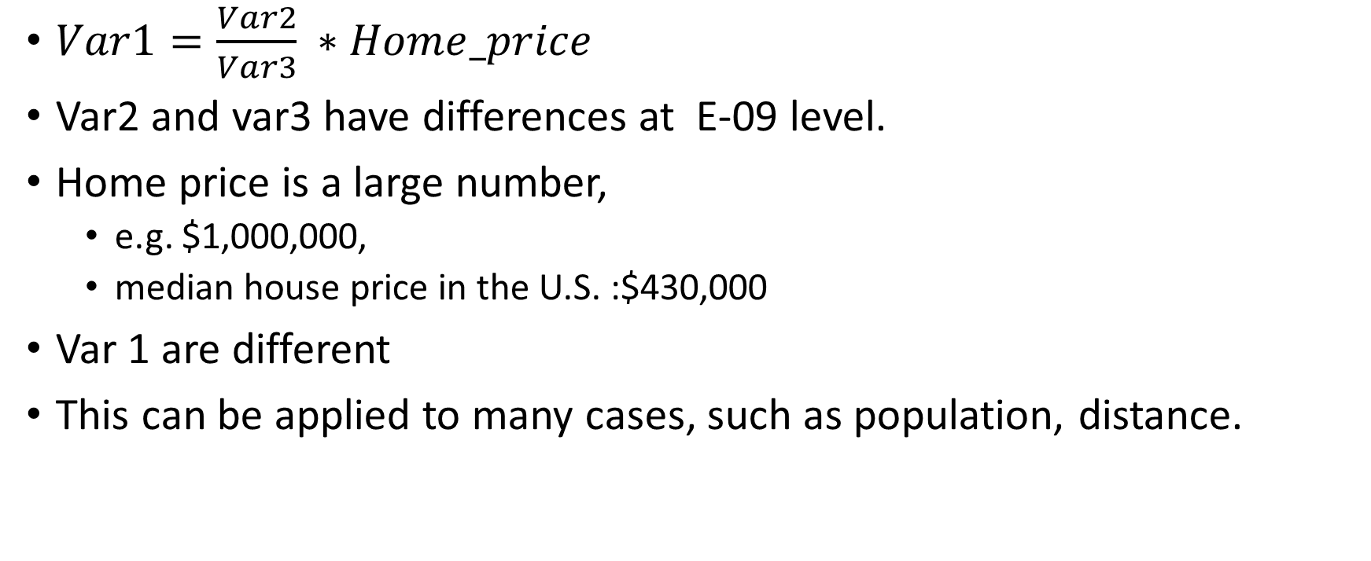
Accuracy
$Var1=\frac{Var2}{Var3} ∗Home_price$
Var2 and var3 have differences at E-09 level.
Home price is a large number,
  e.g. $1,000,000,
  median house price in the U.S. :$430,000
Var 1 are different
This can be applied to many cases, such as population, distance.

Slide 10
Efficiency

Slide 11
Merge Tables
concatenation

Slide 12
What additional value does my approach provide?

Slide 13
Where do we go from there?

Slide 14
Reference:
AWS re:Invent 2021 - Fannie Mae: Migrating at scale without lifting and shifting
Fannie Mae’s Digital Transformation Journey with AWS | Amazon Web Services
What is a Cloud Migration Strategy? - Cloud Migration Strategy Explained - AWS

Slide 15

Q&A
My Github

